Slide 1


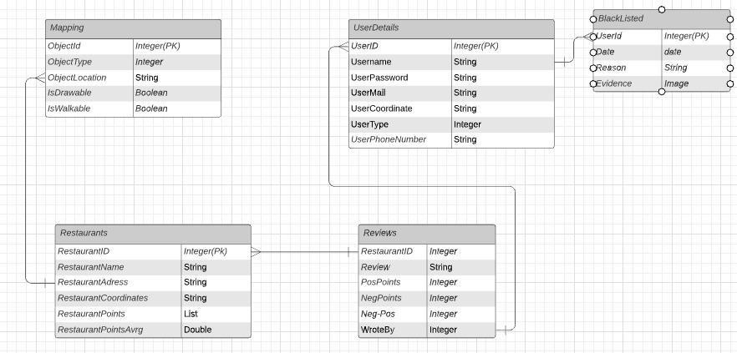
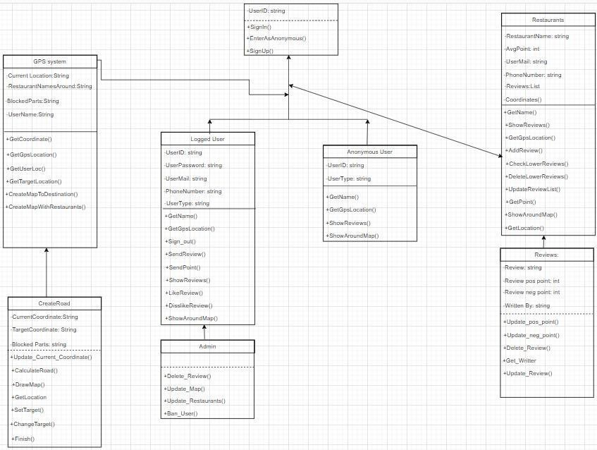
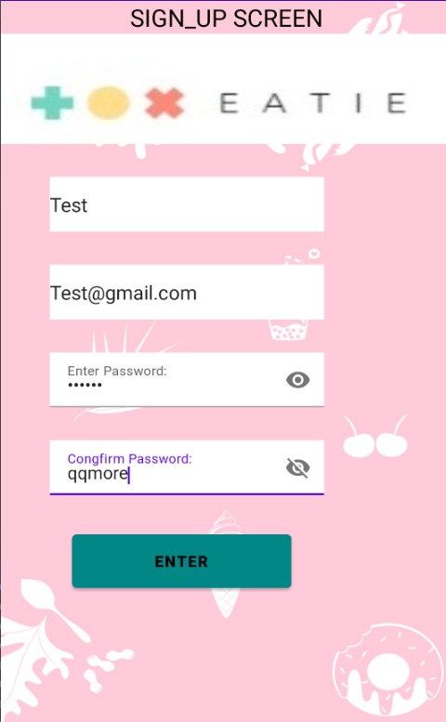
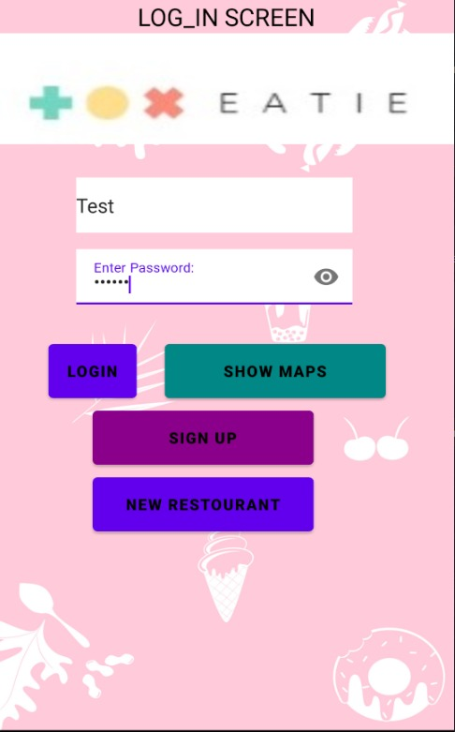
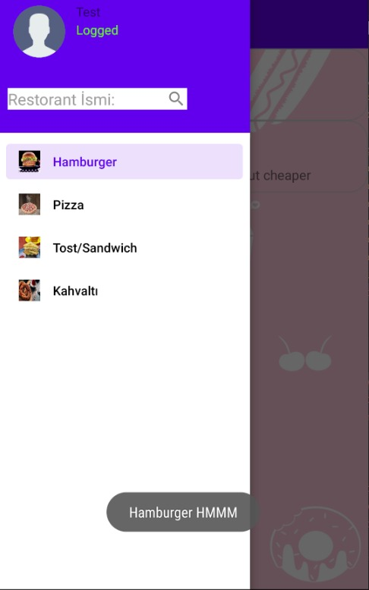



RESTAURANT REVIEWS ACCORDING TO GEOGRAPHICAL LOCATION
Beste Şankaynağı
Baran Yiğit
Coşkun Oruç
Advisor: Doç. Dr. Hadi Hakan MARAŞ
Çankaya University, Department of Computer Engineering
Abstract
Most of us may find it difficult to decide where to go and what to eat while eating. It is even more difficult to decide if it is a place we do not know, and we decided to make an application in order to prevent this situation. This project sorts restaurants by user ratings and distance from the user, and shows other comments made by other users for the restaurant selected.
Keywords: Software development, mobile application
Introduction
“Restaurant Review App according to Geographic Location” is a project for helping users find good restaurants when they can't be so sure about what to eat or which restaurant they would like to go to. Main goal of our project is to help users find restaurants that suit user's tastes by getting tags from users with an easy to use application. Users could also help other users by giving reviews to restaurants they eat from and giving points to restaurants.
This application would help users to find which restaurant they would like to eat at.
Figure 2 – Database Diagram
Figure 1 - Class Diagram
Figure 5 – Finished Product
Results & Conclusion
Eatie offers users both a variety and comparable options. The variety of options provides users with many conveniences such as saving time and easily deciding what they want. With the developed application, the platform is expected to be more attractive to users with different requests such as food and restaurants.
Acknowledgement
We would like to thank our advisor, Prof. Dr. Hadi Hakan MARAŞ, who contributed to the completion of this report.
Solution
The Eatie project is a platform developed as a mobile application for its users to recommend and list restaurants according to their preferences and tastes. By using the necessary filtering options, you can get rid of the option confusion and you can easily reach the right quality thanks to the scoring feature.
Figure 3 – Finished Product
Figure 4- Logo
Figure 6- Our Team

